Slide 1

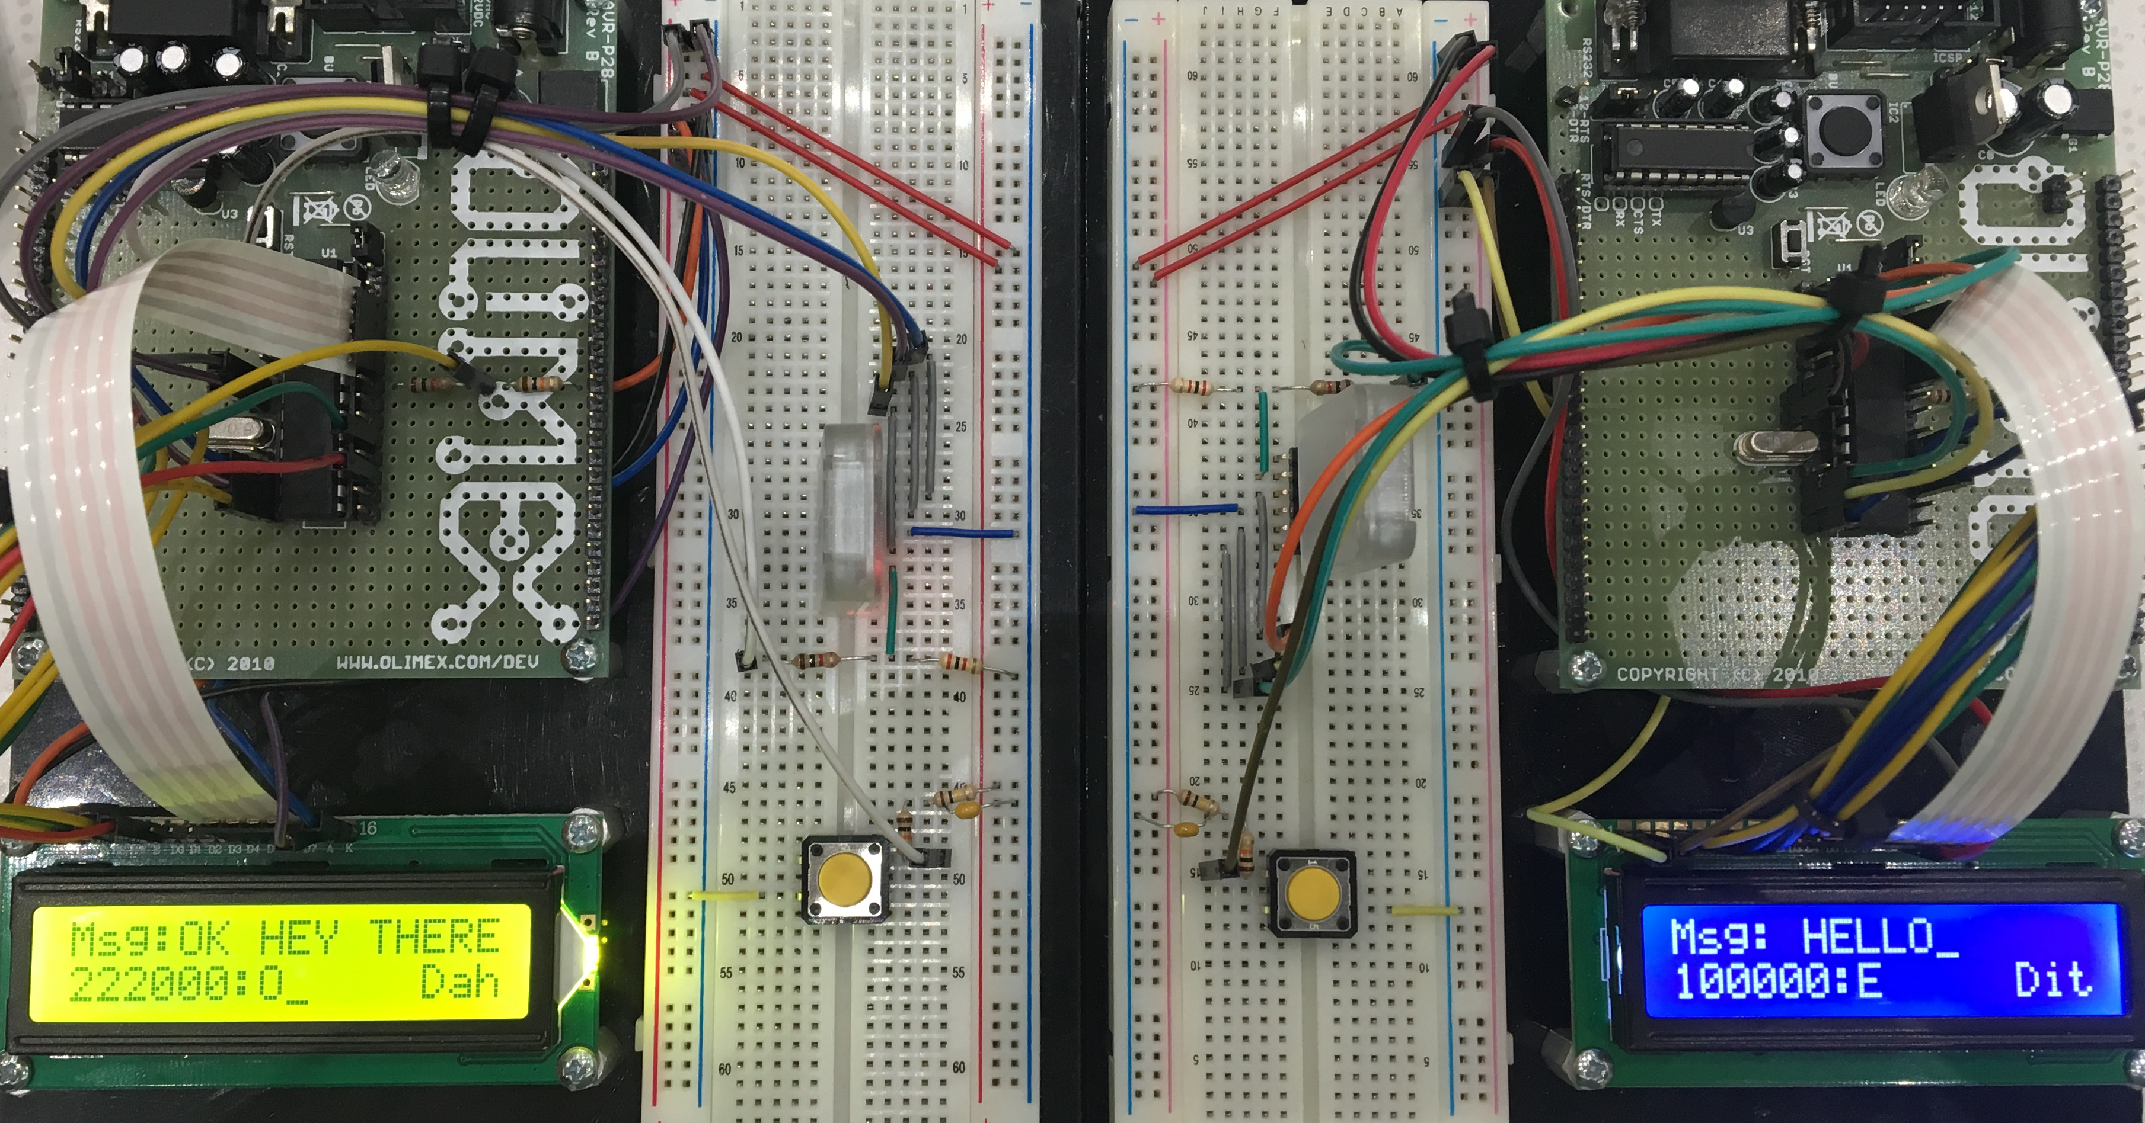
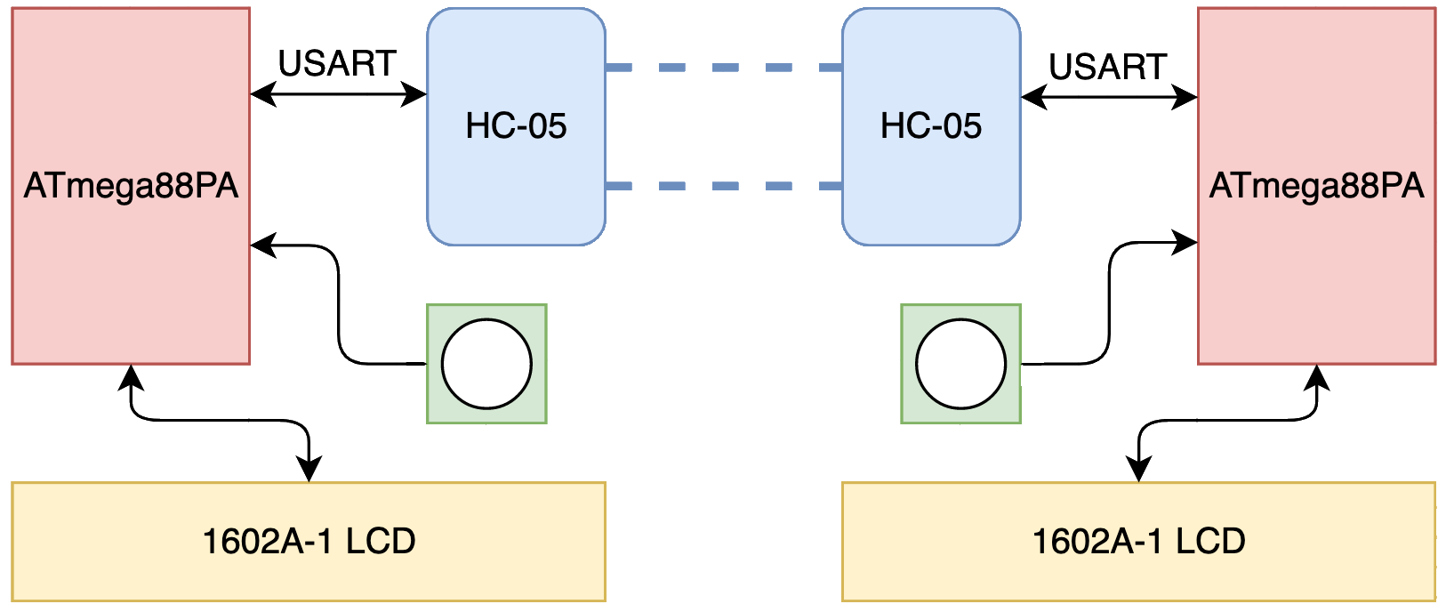
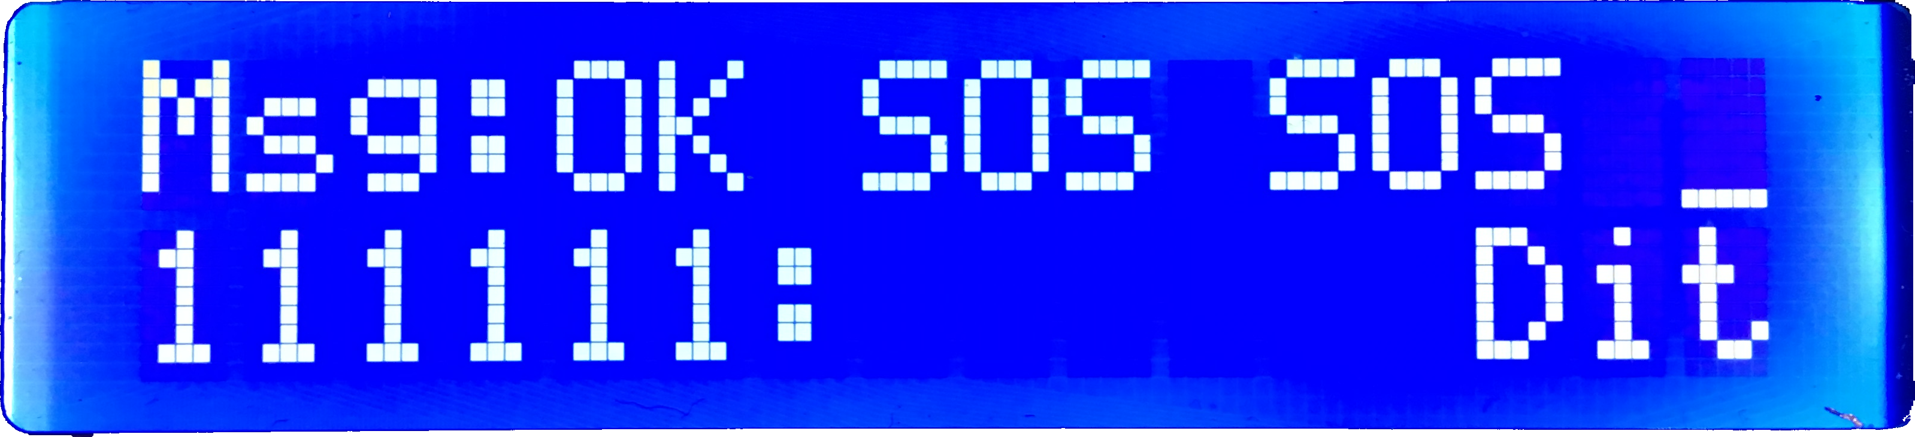
Morse Code Chat
23
Alexander Powers and Benjamin Mitchinson
Abstract
Our project was to design and build a discrete Morse code communication set, programmed on two ATmega88PA development boards. Using our developed solution, two users are able communicate back and forth by tapping out Morse Code on a button, for transmission over Bluetooth to the LCD of their respective partner’s device.
System Design
Result
Our project is able to consistently and accurately interpret and transmit Morse code to another device each running the same compiled code. Because we’ve chosen to send communications one character at a time immediately as they’re entered by the user, there’s very little delay in transmission, and interaction between the two devices is seemingly instant.
Additionally, we were able to use the binding functionality of the HC-05, to ensure that messages will only be transmitted between our two devices, ensuring that other Bluetooth communications will never interrupt our transmissions.
The button is the primary input signal for the system, which the ATmega88PA detects and interprets through a timer interrupt . This decoded Morse code is then sent via USART communication to the HC-05 Bluetooth module, which then forwards the message to the other board’s HC-05 module. Once received by the other ATmega88PA, the Morse code is displayed on the 16021-A LCD. The LCD also displays the current Morse bits, and how the previous button press was interpreted.
Lessons Learned
Conclusion
Reflecting on final physical hardware design, our solution would be more marketable if it was contained in a compact form factor, as opposed to being left on the development board and tethered to an outlet power source. The components are small enough to be wired to one board, and using a battery to power them all would result in an entirely portable communication device.
Our completed solution achieves exactly what we sought out to accomplish. The pairing process of the HC-05 devices is faster and more reliable than originally anticipated, resulting in a consistent and accurate interpretation of Morse code transmission. We also made sure that our sampling method allows for user preferences on the timing of input based on the Farnsworth
Acknowledgments
1
ECE:3360 Embedded Systems 2019
The University of Iowa

